Slide 1
SP4 Team 11
Gregory Koh
Job Jacela
Almeda Glenn
Rayson Poh

Slide 2


Slide 3
Overview
Game Concept
The Games
Lessons Learnt

Slide 4
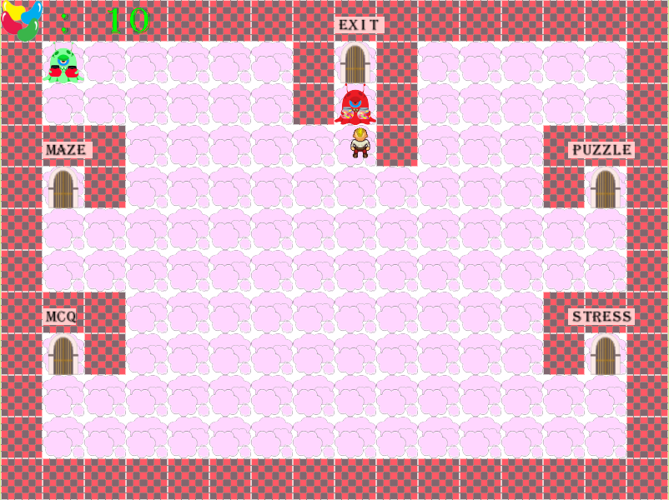
Game Concept
Role-play as a boy trapped in “The Guardian’s Den”
Play 4 different mini-games to collect “Jellybeans” to offer to “The Guardian”

Slide 5
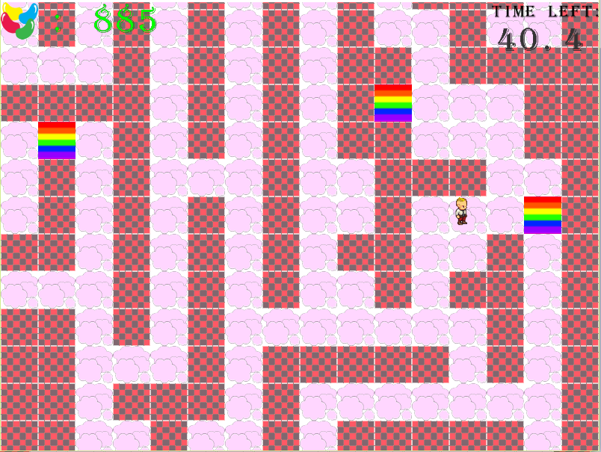
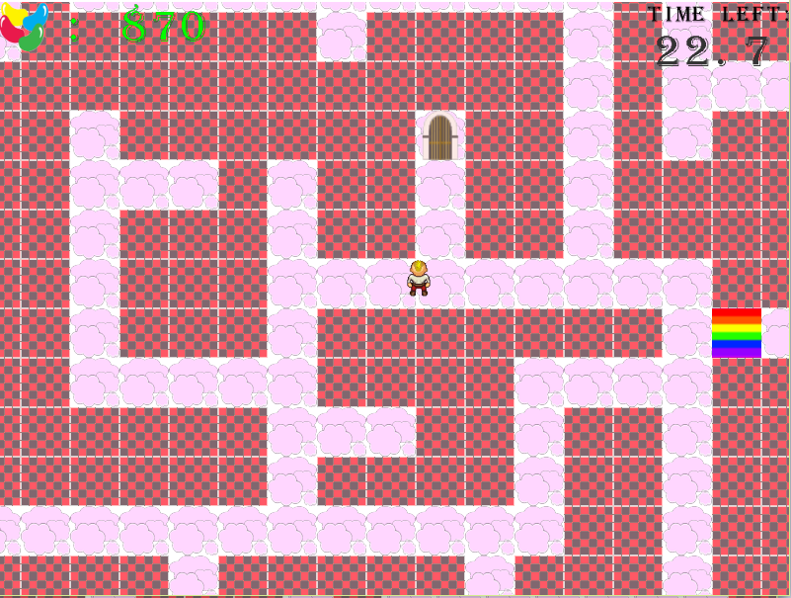
The Games
Game 1 (Maze Runner)

Slide 6
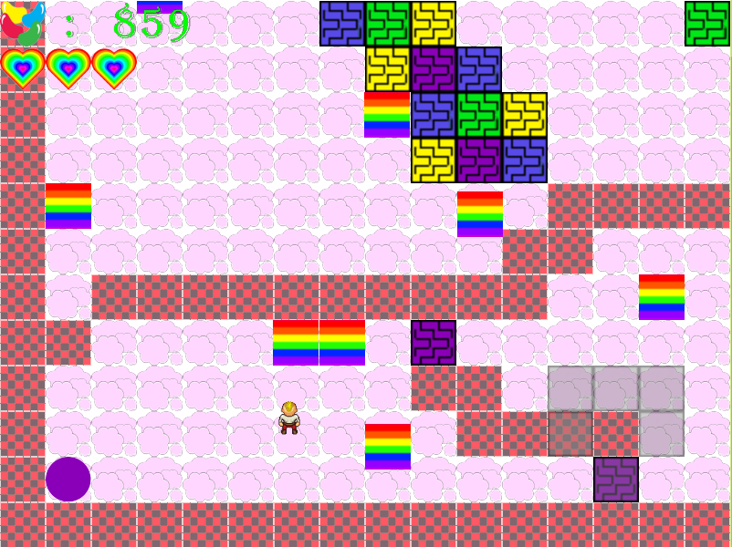
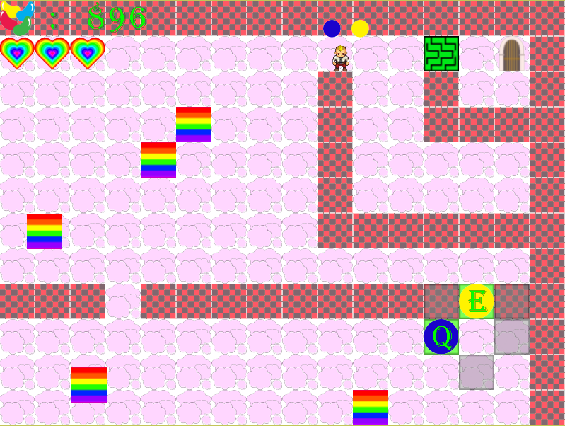
The Games
Game 2 (Puzzle Party)

Slide 7
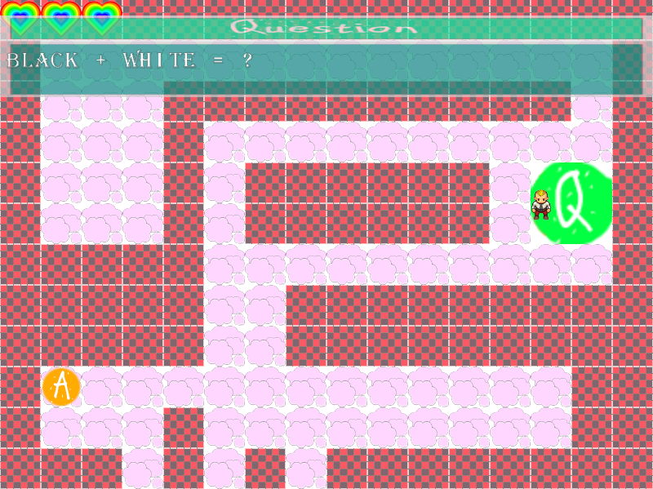
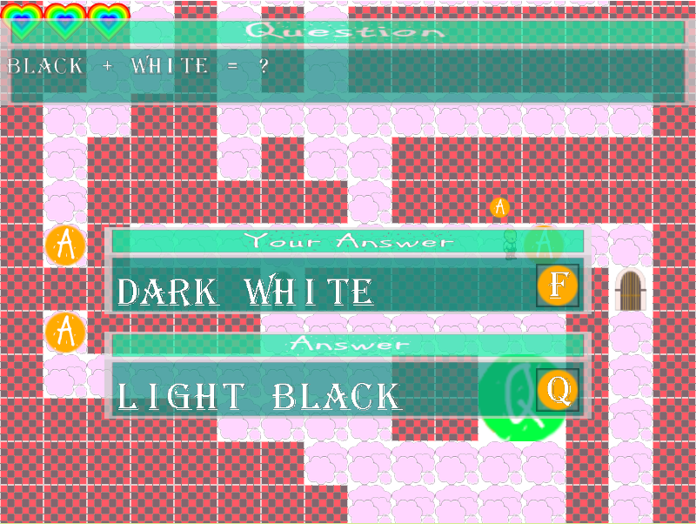
The Games
Game 3 (MCQ Power)

Slide 8
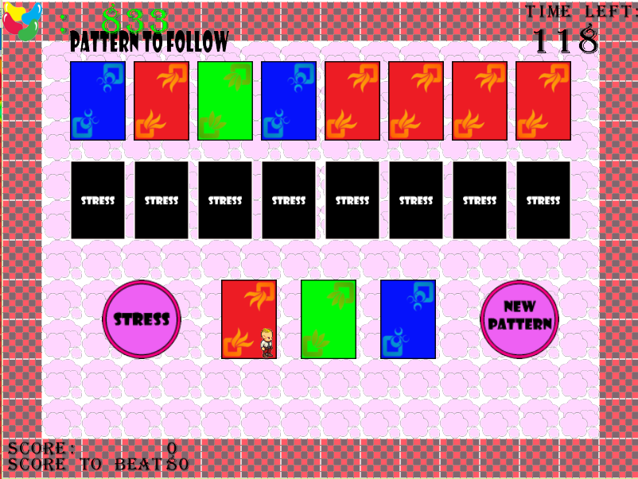
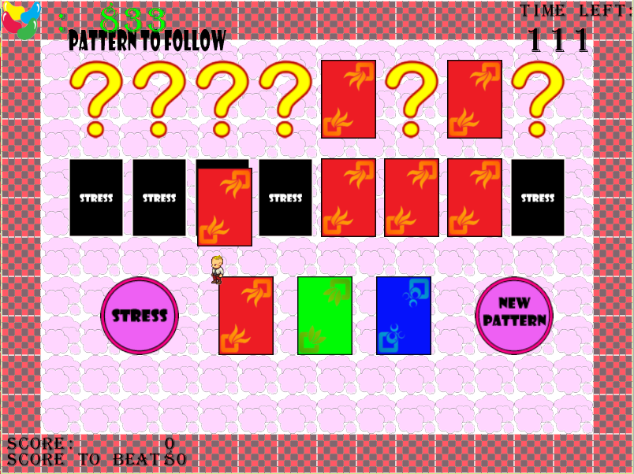
The Games
Game 4 (Stress)

Slide 9
Lessons Learnt
Be quick in developing
Learn to cut features
Communications is very important
Following a common game theme

Slide 10
Gregory’s Task List
Game 1
Framework
Jellybeans system
Difficulty selection system
AABB
Load and save
Confirmation pop-up windows
Credits
Reduction of warnings in whole solution

Slide 11
Job’s Task List
Game 2
Lua scripting class
Game Hub
AI (FSM)
Doors class
Documentation
Gantt chart, User guide, Finished task list

Slide 12
Glenn’s Task List
Game 3
Music System
Game State and Scene Management
Game 3 (MCQ Power)
Object Class
Question/Answer Classes
Waypoints
Pause Menu
Docmentation
Game Report, Presentation Slides, Trailer Video

Slide 13
Rayson’s Task List
Game 4
Entire UI system
Buttons, animations,etc
Main menu
Settings
Card class
Reduction of warnings in entire solution

Slide 14
End

